Slide 1

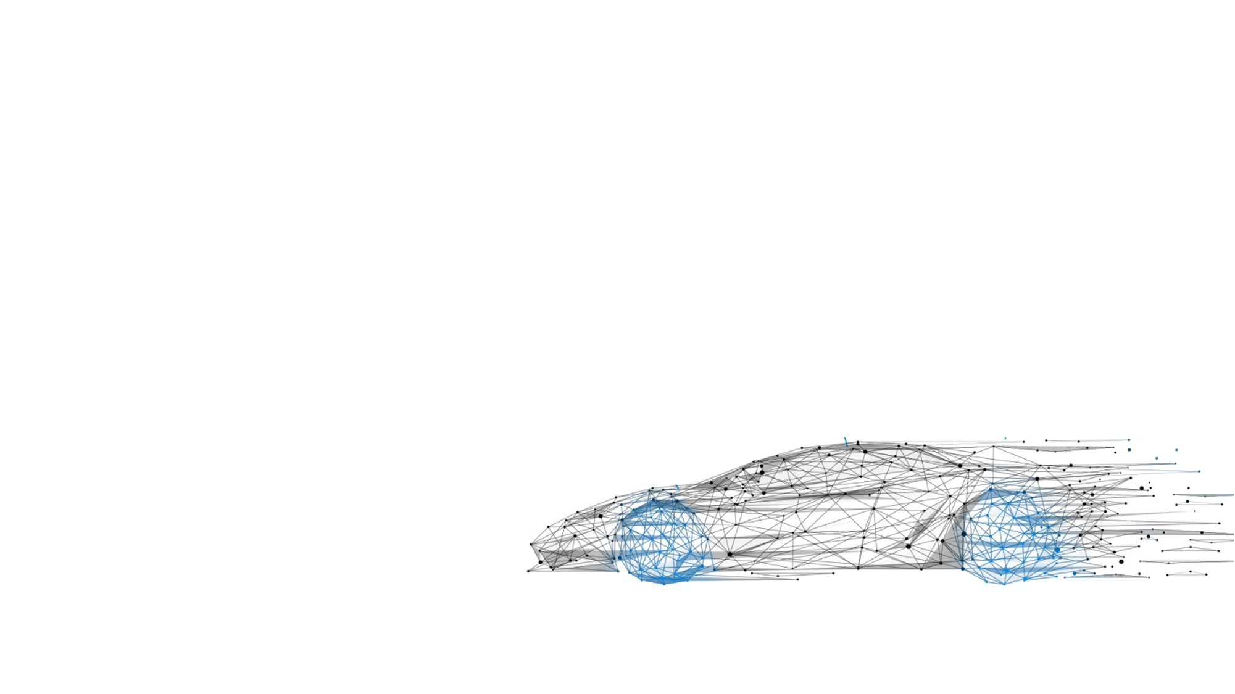
Motor Design Presentation
EV 2W Motor
Enabling Mobility Solutions
1

Slide 2
Contents
Powertrain Sizing and Assumptions
2. Design Parameters and Sensitivity Analysis
3. Design Simulation and Validation
4. Performance Analysis and Validation
5. Conclusion
Enabling Mobility Solutions
Strictly Confidential

Slide 3
Powertrain Requirements
Rated Power = 7.5kW to 9.5kW
Base Speed = 3000 RPM to 4000 RPM
Peak Speed = 5500 to 6000 RPM
Voltage = 72Vdc
Motor Mass = 8kg to 10kg
Cooling = Blown Over Natural Convection via Fins
Vehicle Gross Weight = 300kg (Kerb + 2 Healthy Adults + Payload)
(140+(2*75)+10 kg mass split-up)
Efficiency > 90%
Vehicle Top Speed = 80kmph +
Acceleration (0-60kmph) < 7 secs
Enabling Mobility Solutions
Strictly Confidential
3

Slide 4

Design and Environment Considerations
Number of stator slots = 12
Number of rotor poles = 10
Drive Layout: Horizontally mounted
Rotor: Interior Permanent Magnet
Performance Targets: WLTP Class-I
Stator Laminate Diameter < 150mm
Ambient Temperature = 40 C
Stack Length < 120mm
Operating Temperatures <140 C
Winding Type: Lap Wye Wound
Winding Design: Full Pitch Winding
Overall Efficiency > 90%
Enabling Mobility Solutions
Strictly Confidential
4

Slide 5
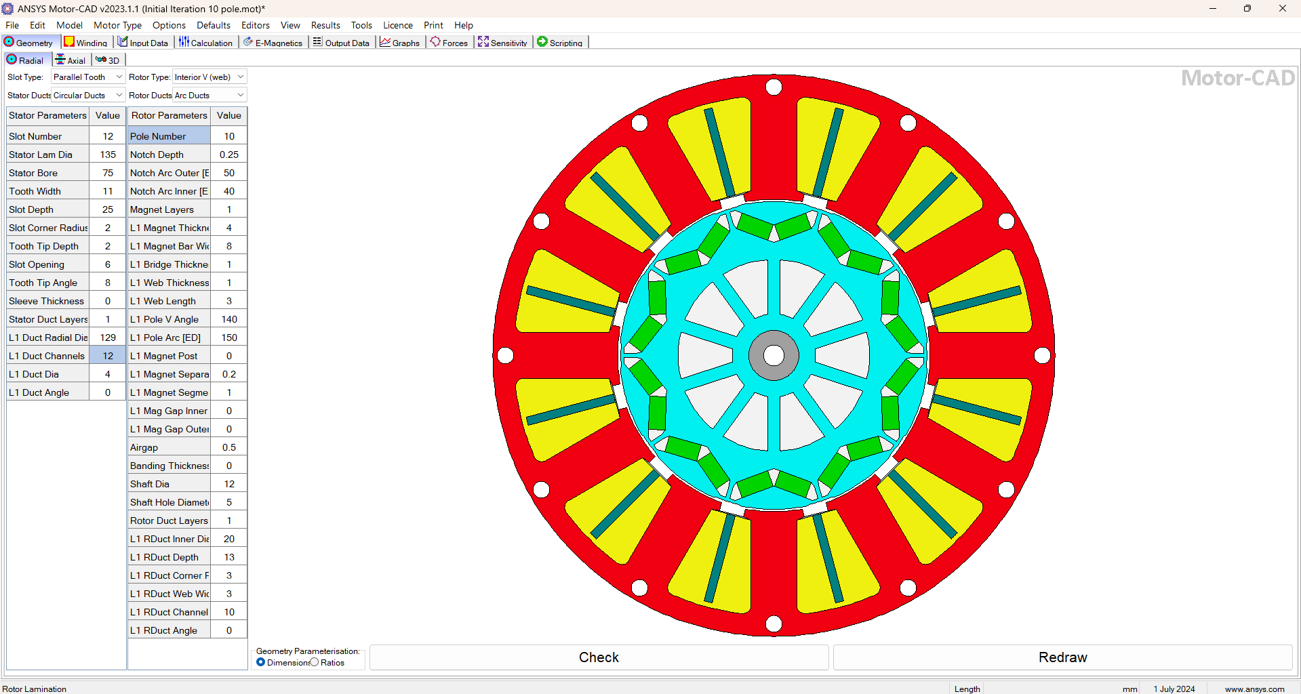
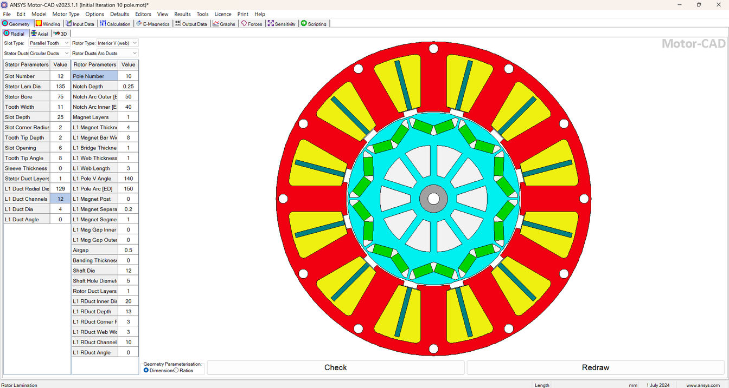
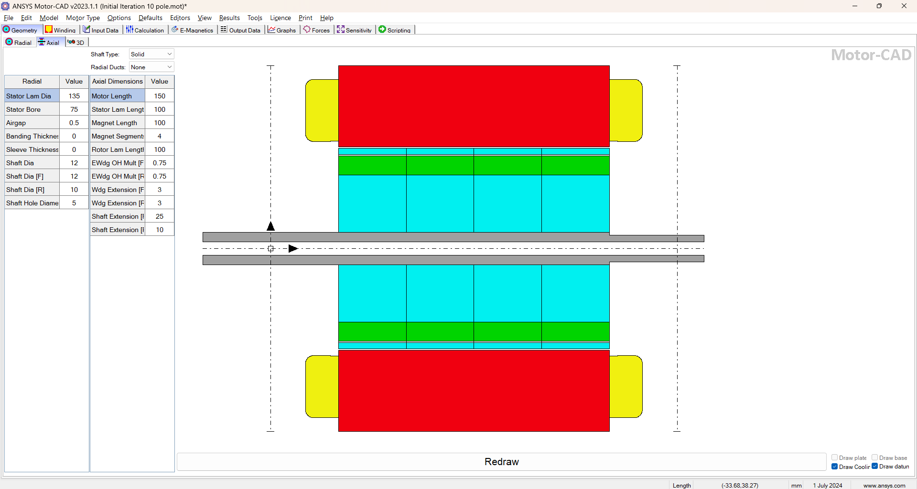
Final Design Parameters
Enabling Mobility Solutions
Strictly Confidential
5

Slide 6
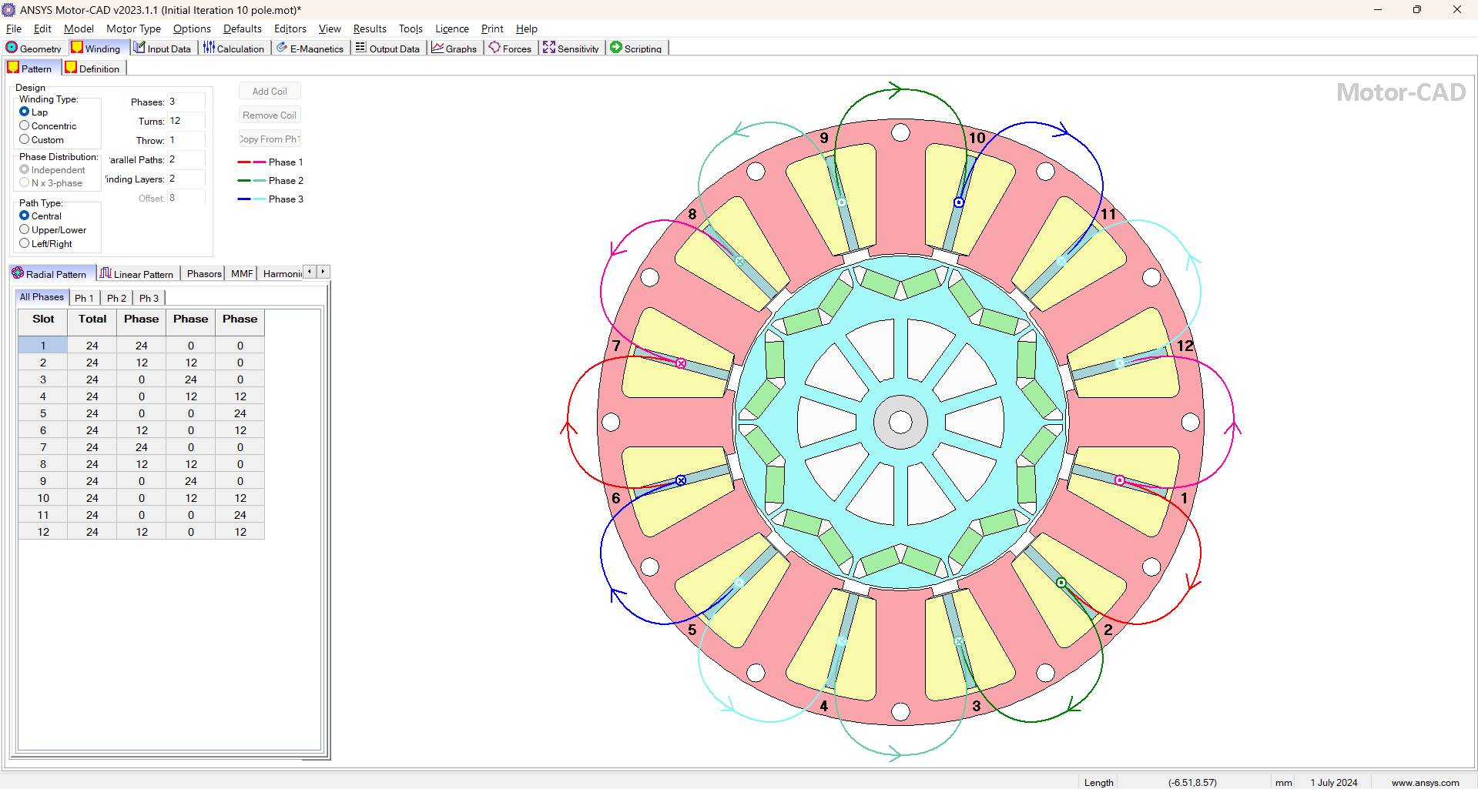
Windings
Enabling Mobility Solutions
Strictly Confidential
6

Slide 7
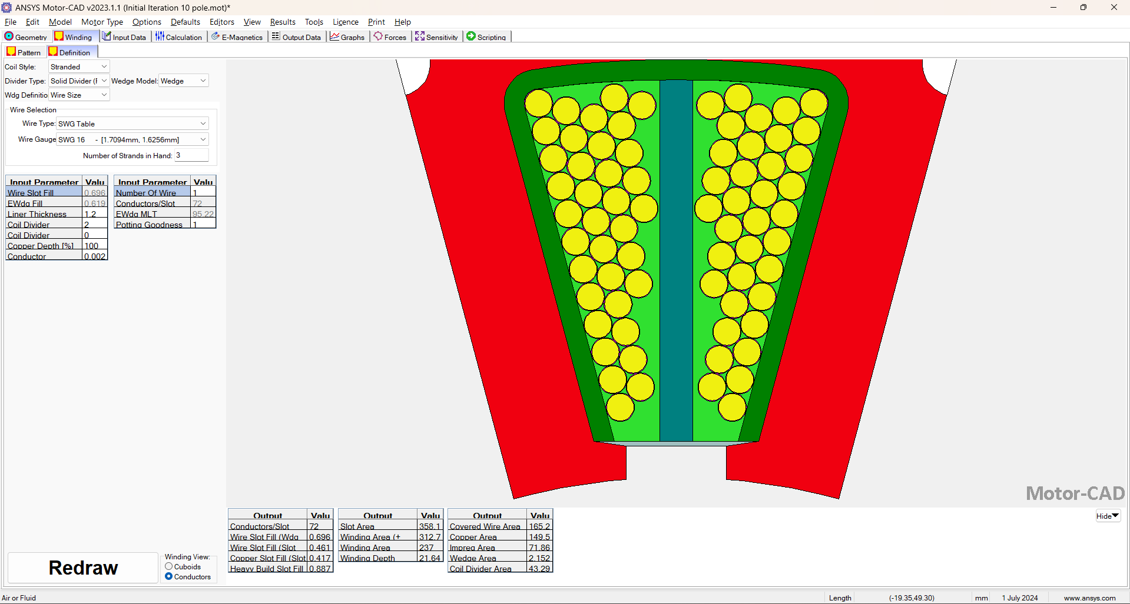
Windings
Enabling Mobility Solutions
Strictly Confidential
7

Slide 8
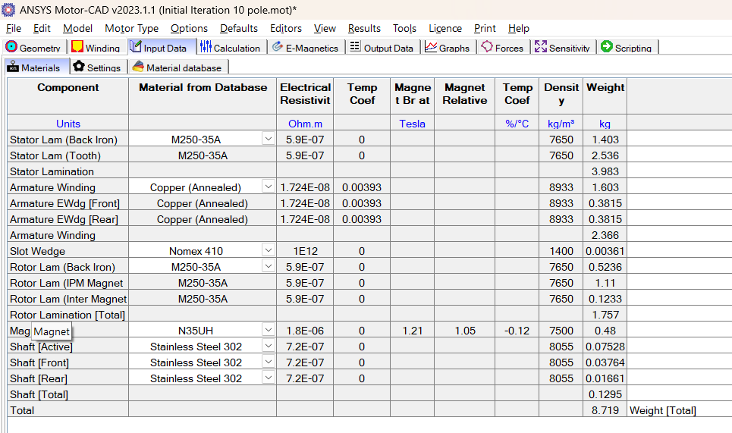
Materials
Enabling Mobility Solutions
Strictly Confidential
8

Slide 9
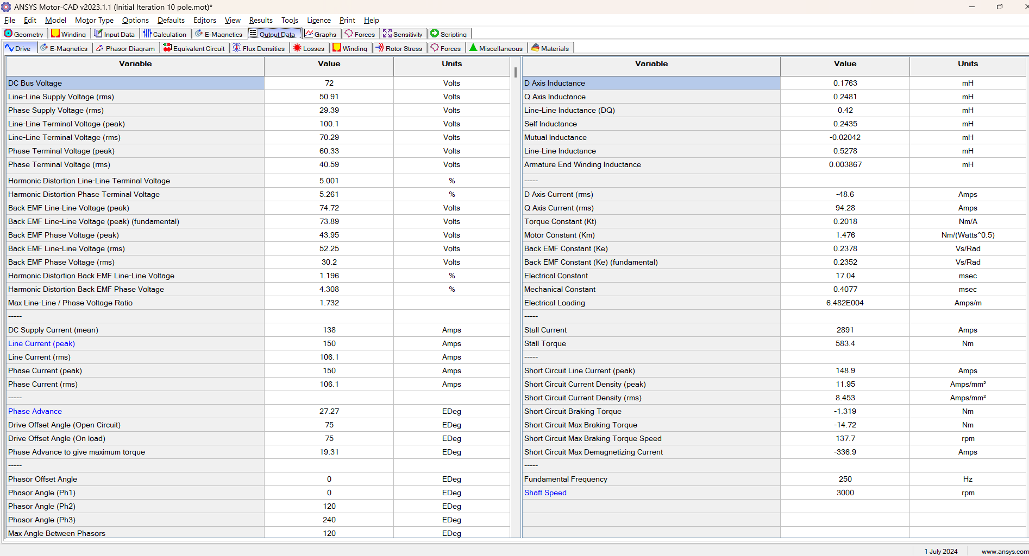
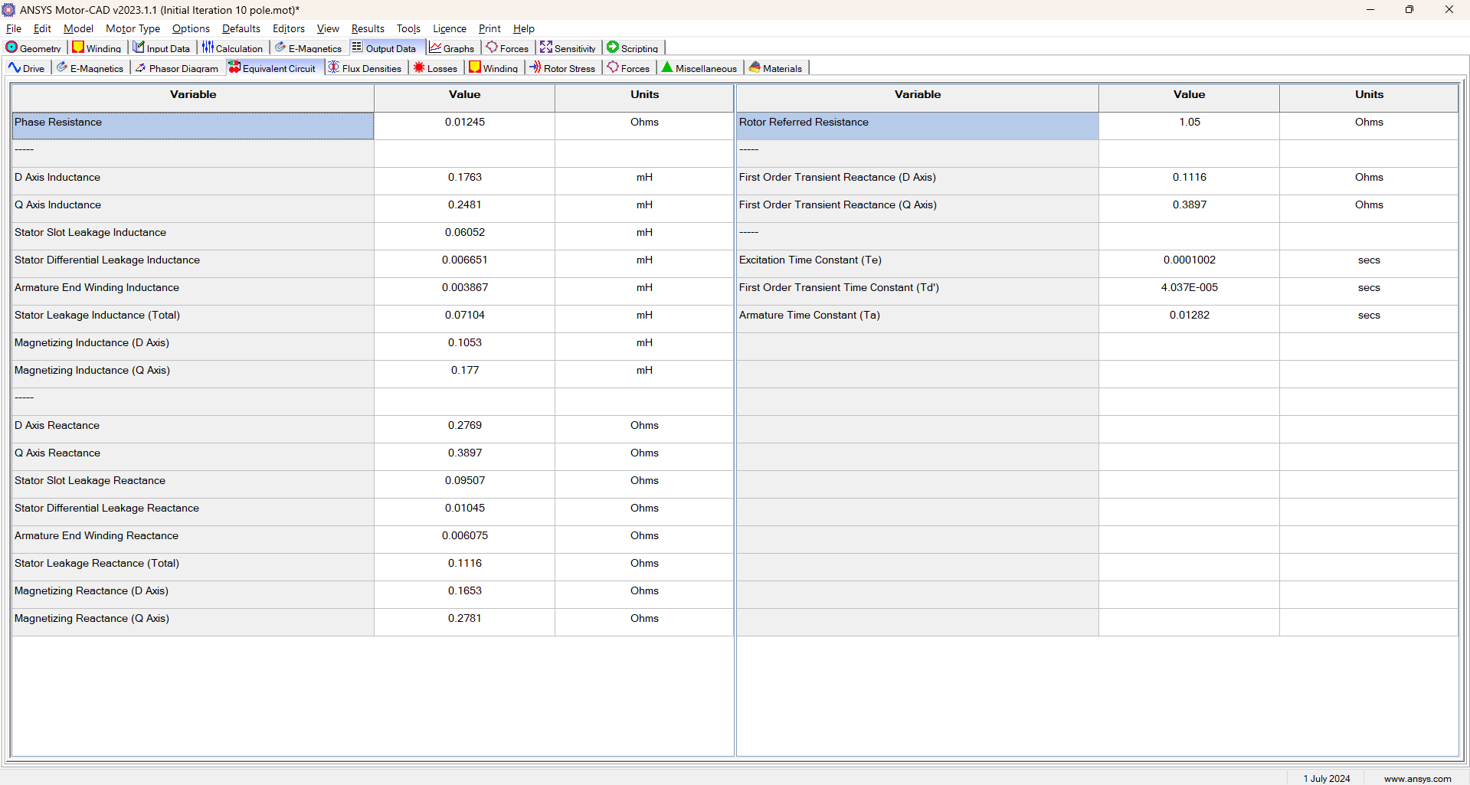
Motor Performance Parameters
Enabling Mobility Solutions
Strictly Confidential
9

Slide 10
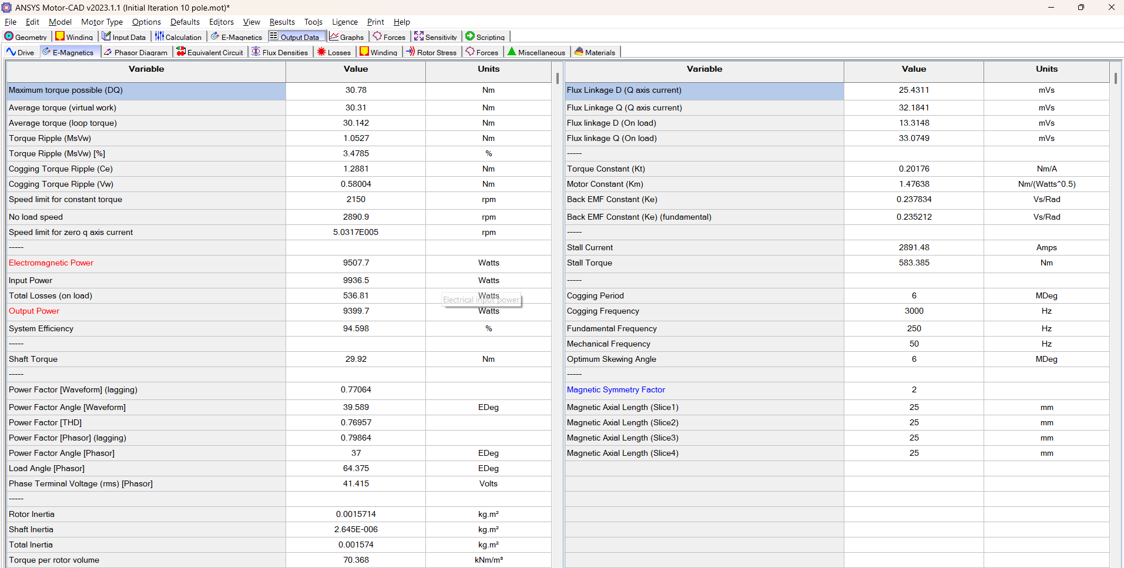
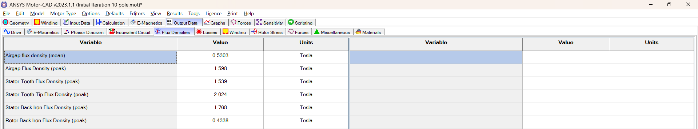
Motor Performance Parameters
Enabling Mobility Solutions
Strictly Confidential
10

Slide 11
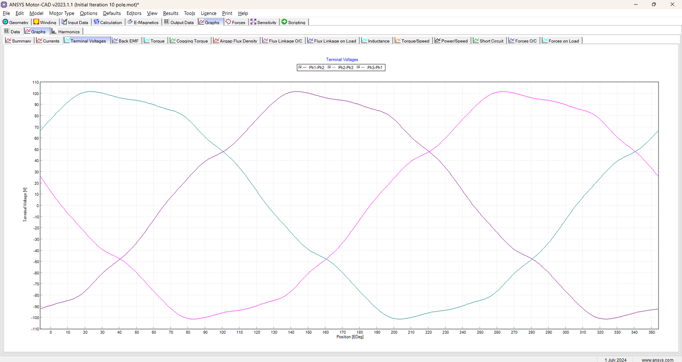
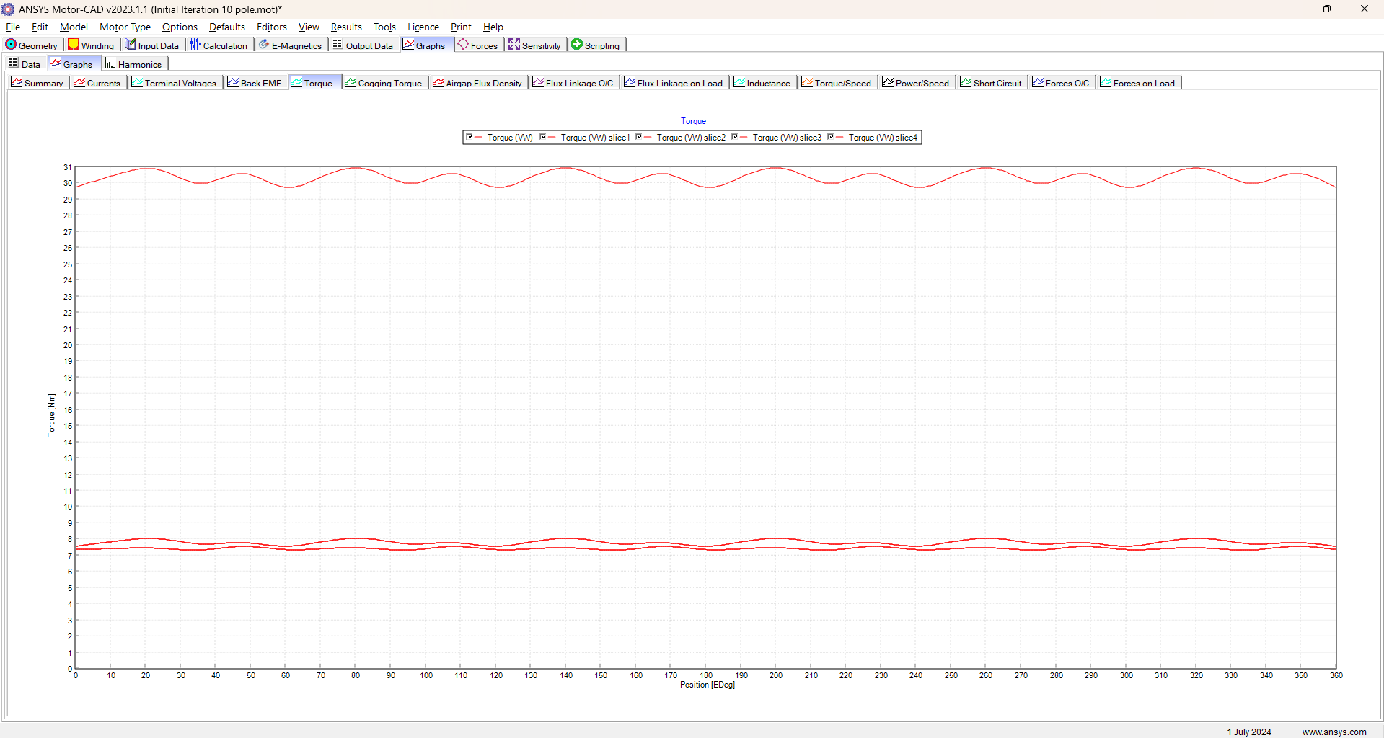
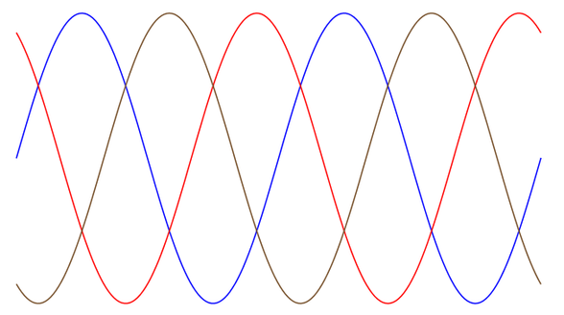
Motor Performance
Torque Ripple
Torque Ripple is the Peak-Peak torque fluctuation value defined in percentage to the peak torque value
Terminal Voltages
The closer the voltage curves resemble to the Sinusoidal Waveform, Performance and Efficiency is directly improved by adjusting parameters of stator and rotor geometry or just by the windings
Enabling Mobility Solutions
Strictly Confidential
11

Slide 12
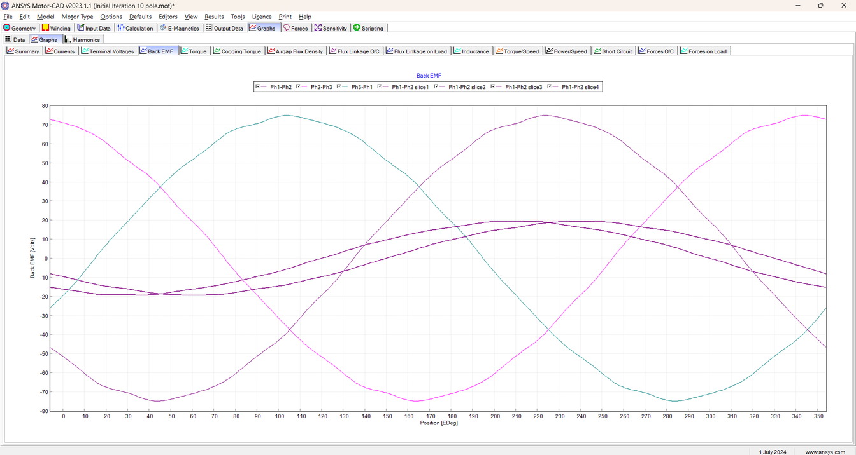
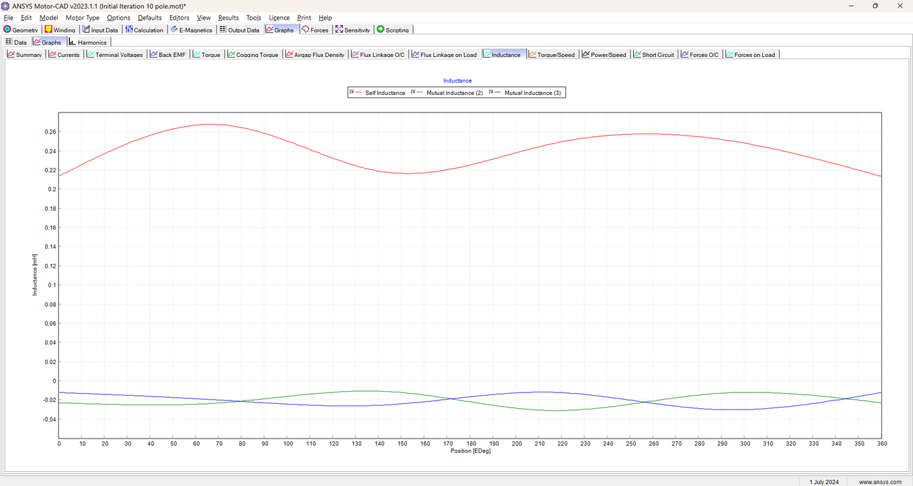
Motor Performance
Inductance
Back-EMF Voltage
Add a little bit of body text
Enabling Mobility Solutions
Strictly Confidential
23

Slide 13
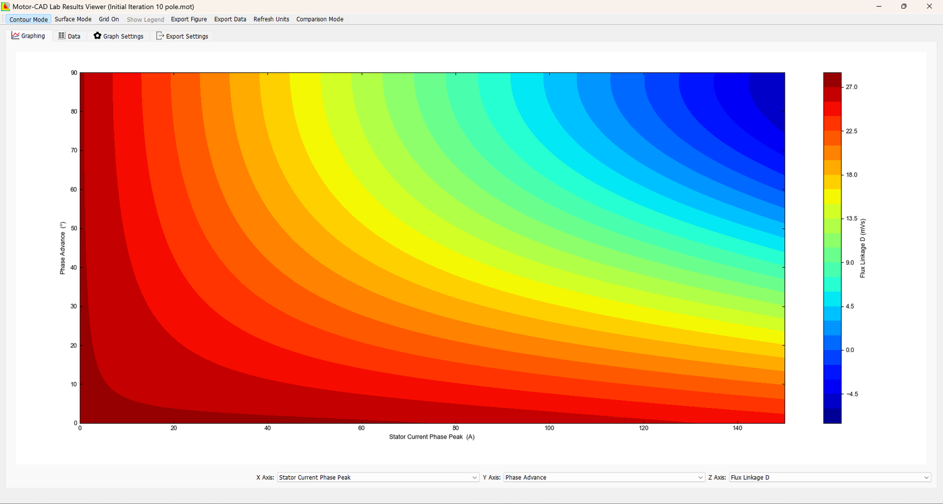
Saturation Map
Enabling Mobility Solutions
Strictly Confidential
13

Slide 14
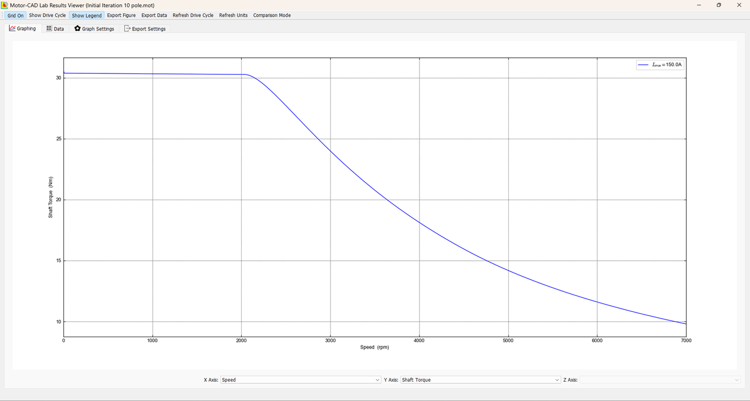
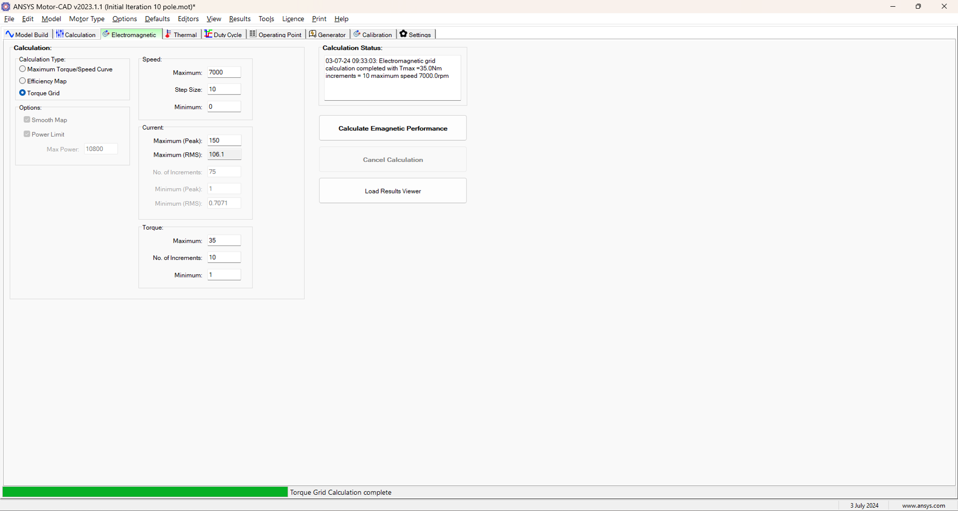
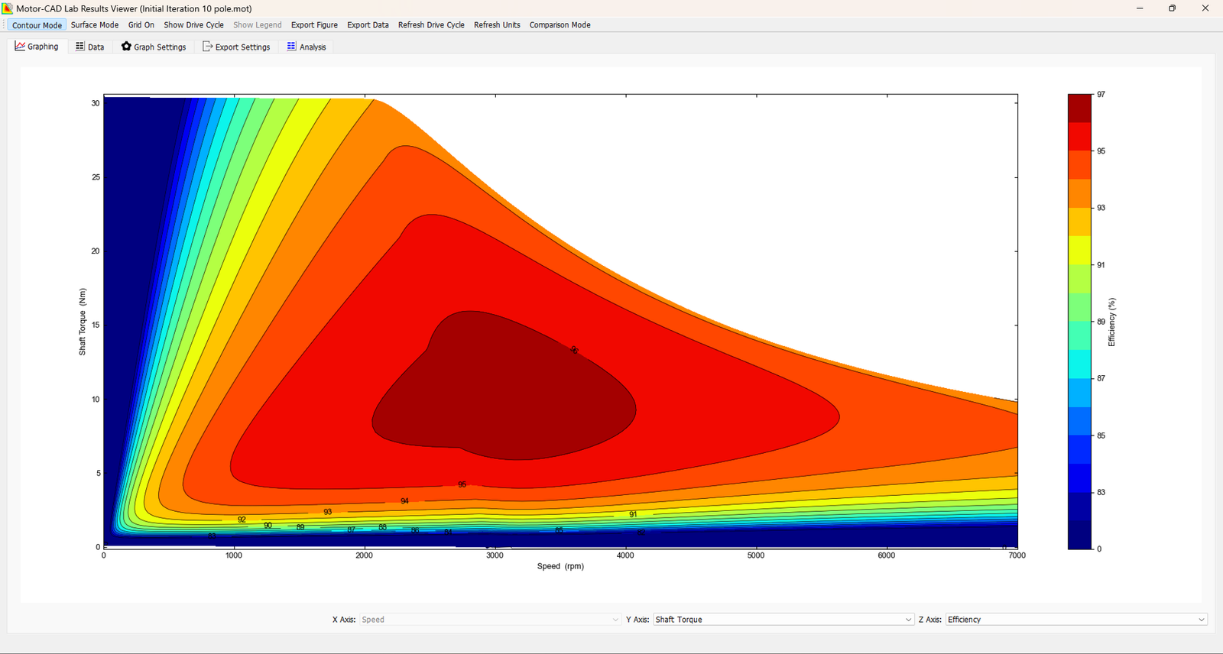
Transient Performance Metrics
Enabling Mobility Solutions
Strictly Confidential
14

Slide 15
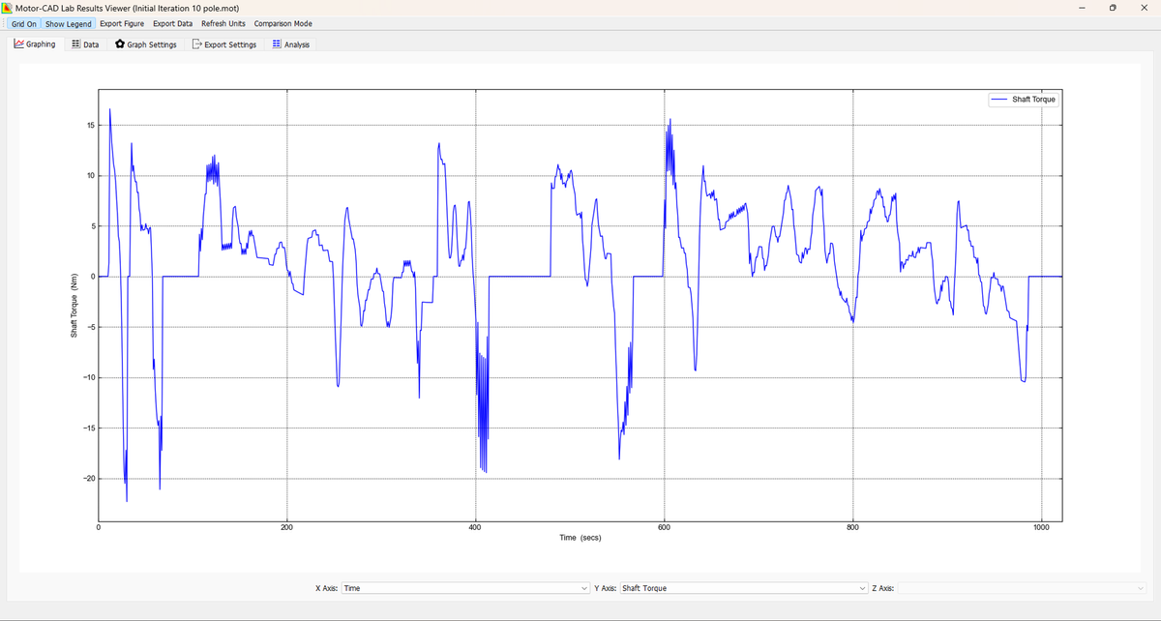
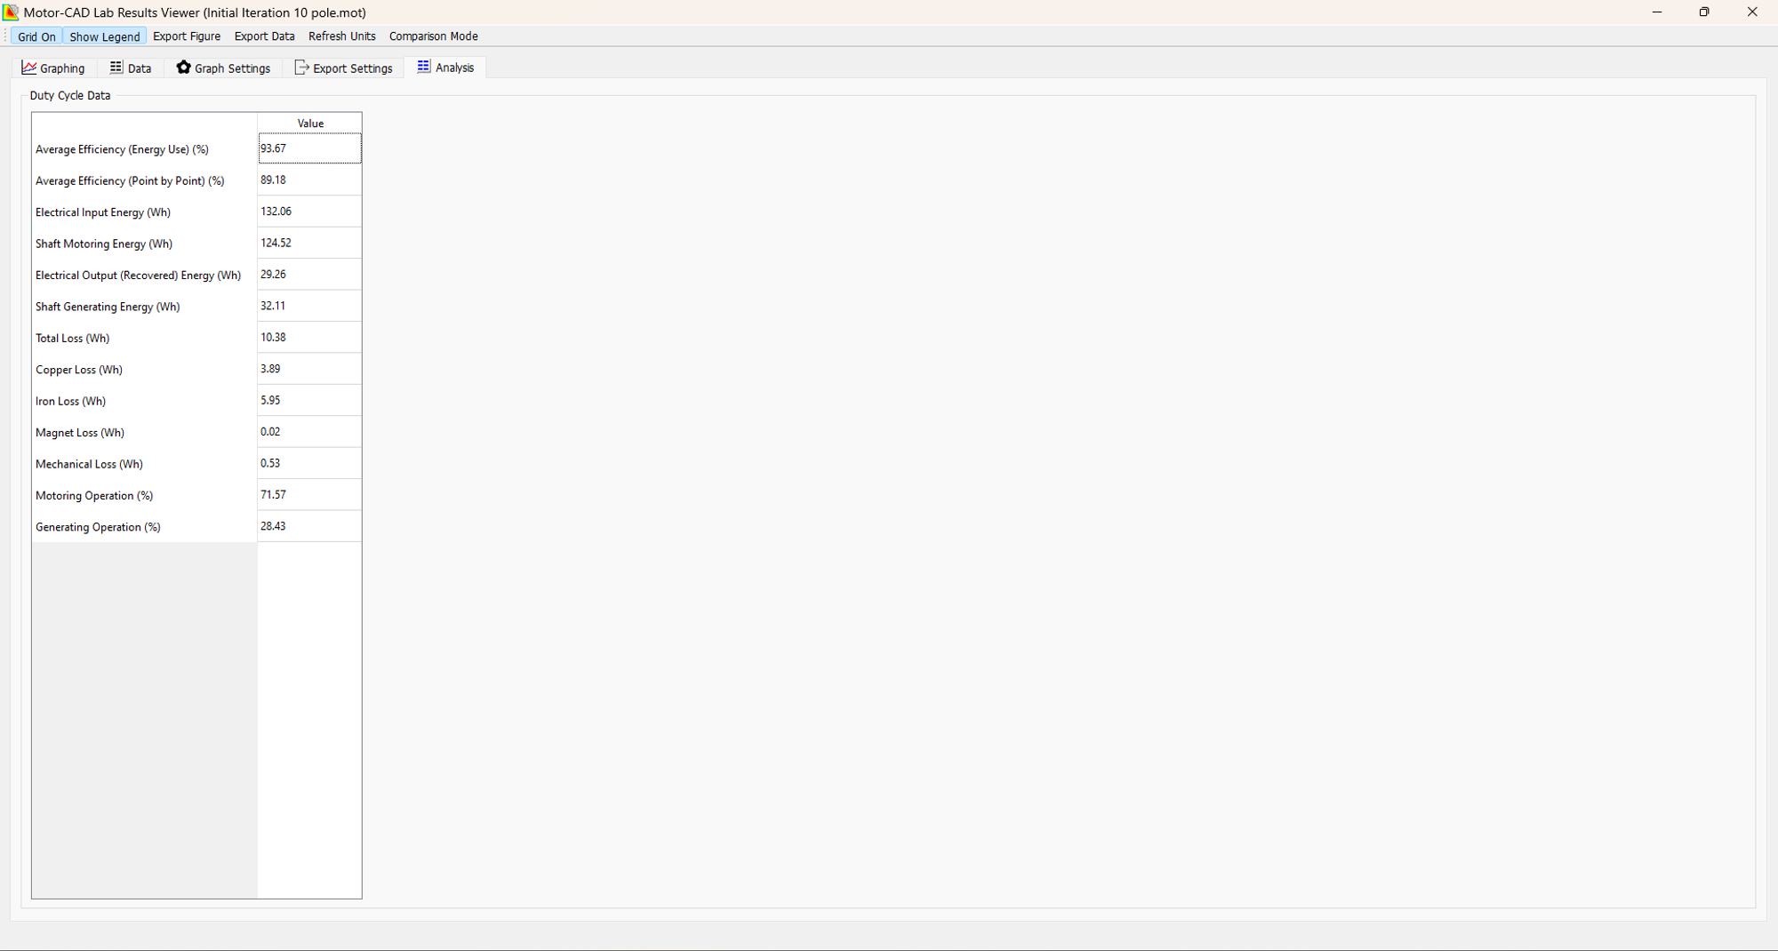
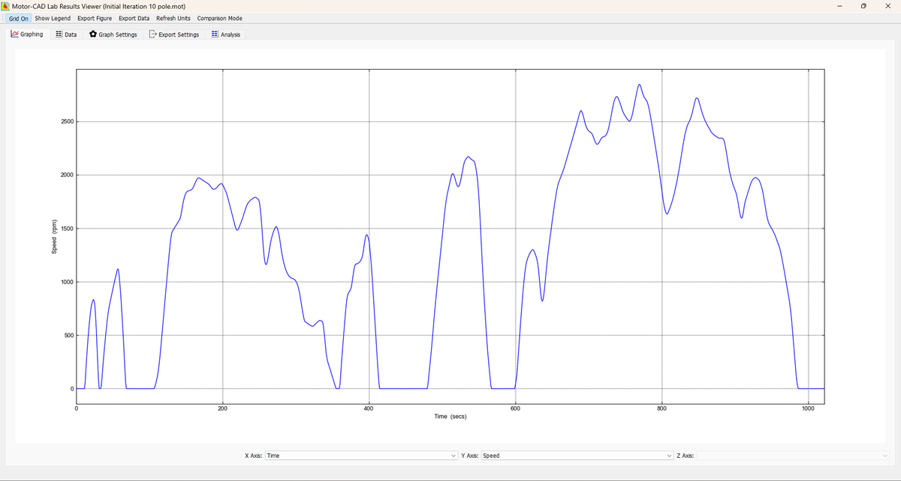
Drive Cycle Mechanical Performance
Shaft Torque
Shaft RPM
Enabling Mobility Solutions
Strictly Confidential
15

Slide 16
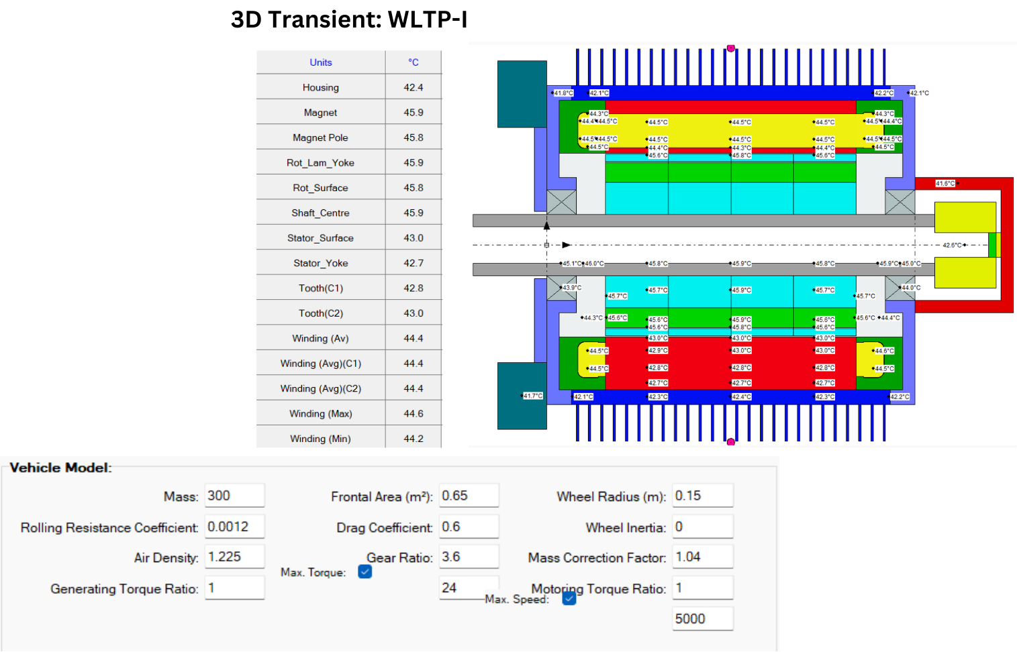
Drive Cycle Thermal Performance
Enabling Mobility Solutions
Strictly Confidential
15

Slide 17
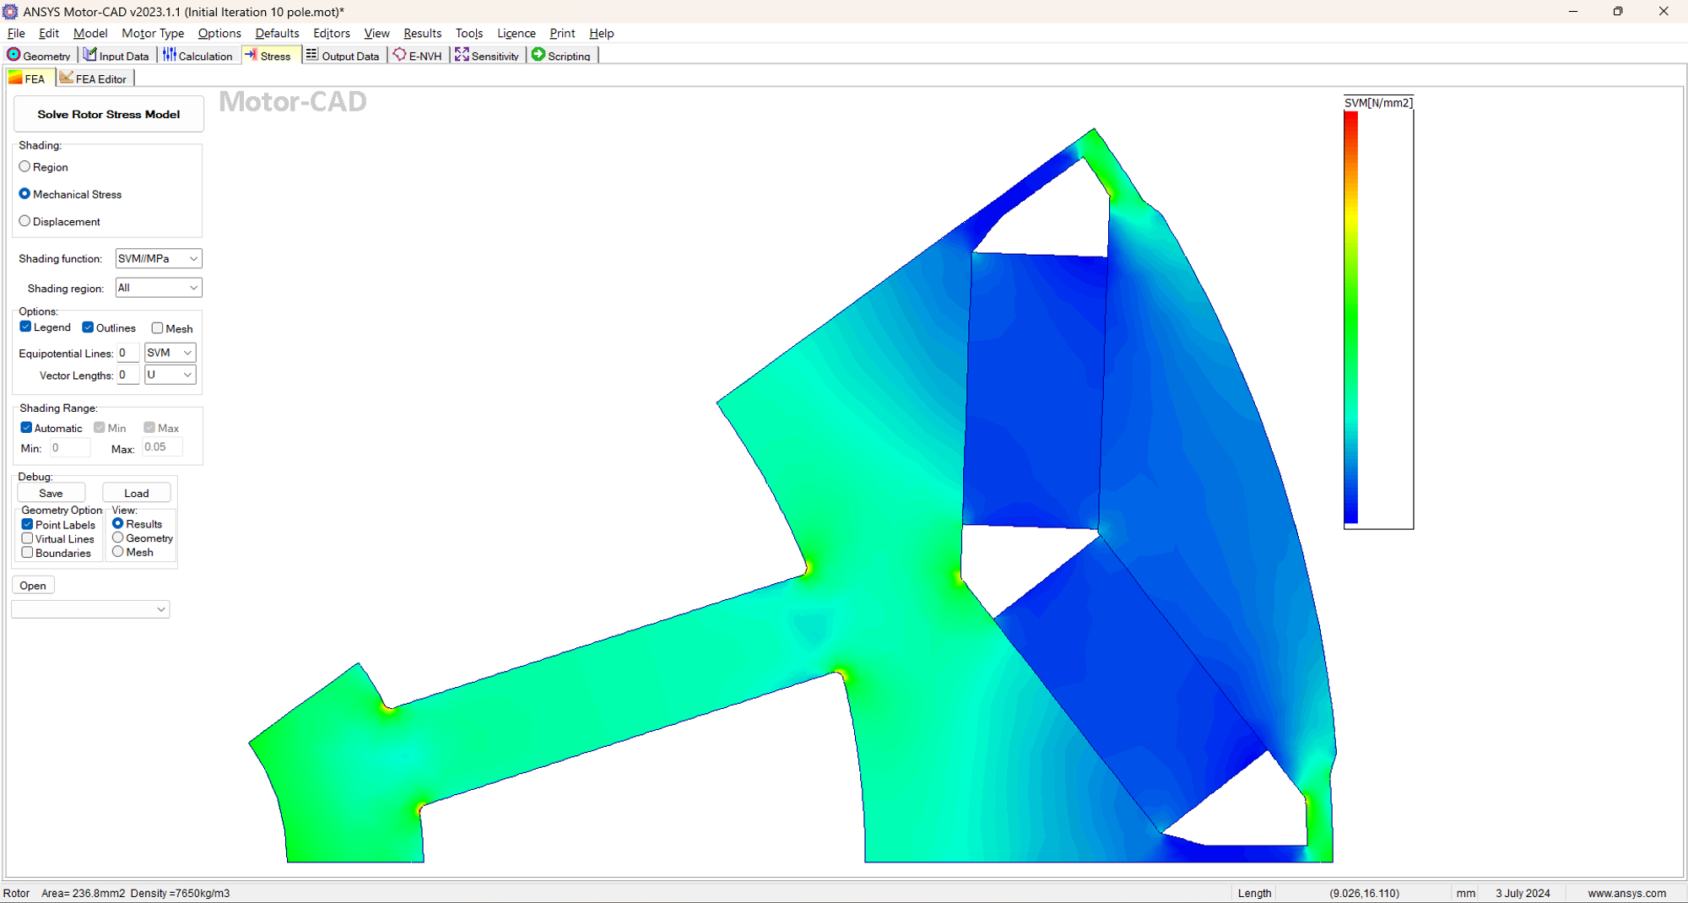
Mechanical Stress Analysis
Enabling Mobility Solutions
Strictly Confidential
16

Slide 18
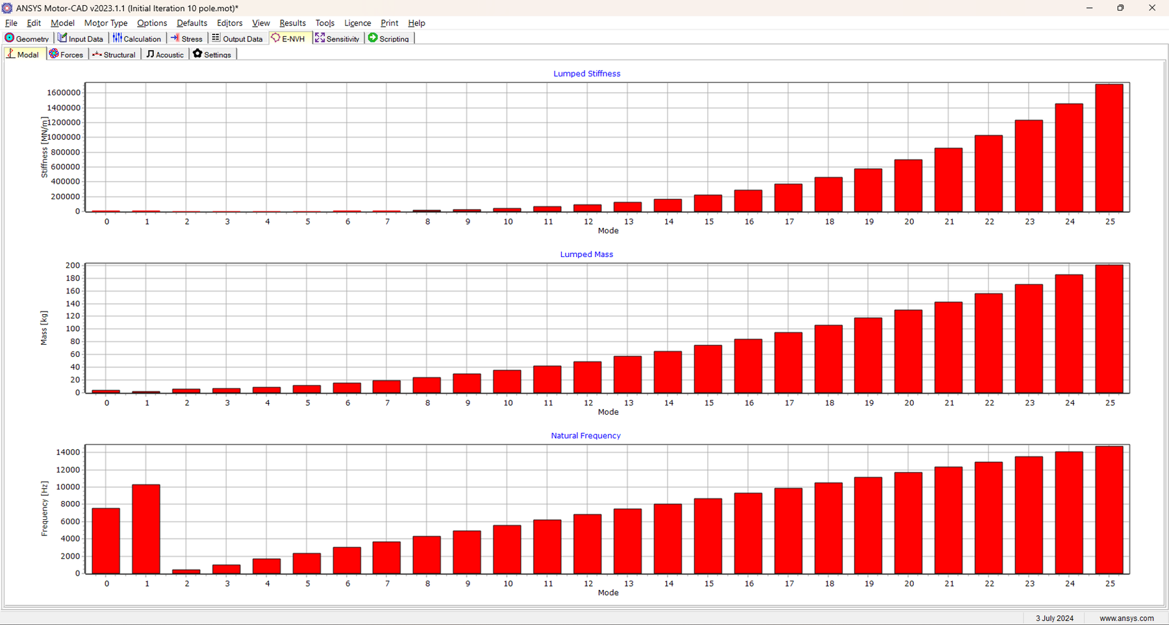
Secondary Performance Characteristics
Modal Analysis
Enabling Mobility Solutions
Strictly Confidential
17

Slide 19
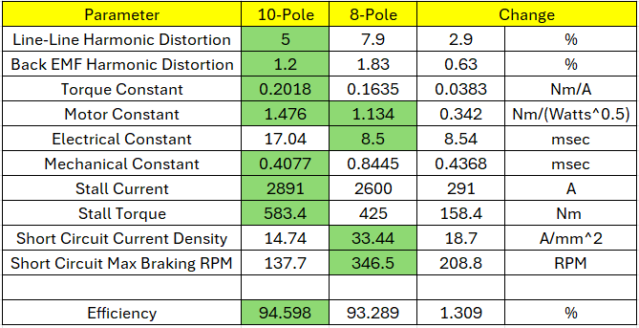
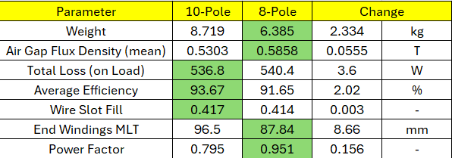
10 Pole vs 8 Pole
Enabling Mobility Solutions
Strictly Confidential
18

Slide 20

Thank You
Enabling Mobility Solutions
Strictly Confidential
19
TACO Prestolite Electric Pvt Ltd

